Slide 1


Darwin García
September 20th 2025

Slide 2

Outline
Executive Summary
Introduction
Methodology
Results
Conclusion
Appendix

Slide 3
Executive Summary
Summary of methodologies
Understanding the business and Data Analytic approach
Data Collection and preparation using SpaceX API and Web Scrapping
Data understanding using EDA, Cleaning, Wrangling techniques
Modeling, Evaluation and Interactive Visualization
Summary of all results
EDA Results
Dashboard
Classification
Telling to Stakeholders

Slide 4
Introduction
Project background and context
The goal is to understand and analyze the successful landing results of SpaceX's Falcon 9 rocket and estimate the cost of each launch that we can apply to the new starship company SpaceY.
Problems you want to find answers
Understand how Space X Falcon 9 works through data
Predict if Space X Falcon 9 fist stage will land successfully apply data in Space Y company
Determine the accuracy and certainty of the Falcon 9 landing successfully
What data can help SpaceY's business model create an innovation strategy that can compete with SpaceX?

Slide 5

Section 1

Slide 6
Methodology
Executive Summary
Data collection methodology:
Data was collected using
Space X API
Web Scrapping
Perform data wrangling
Checking and sorting landing outcome data to determine the best data training
Perform exploratory data analysis (EDA) using visualization and SQL
Perform interactive visual analytics using Folium and Plotly Dash

Slide 7
Methodology
Executive Summary
Perform predictive analysis using classification models
Split data
Training different machine learning models
SVM
KNN
Decision Tree
Logistic Regression
Find the best method using Grid-Search Hyperparameter
Modeling & Evaluation

Slide 8
Data Collection
Describe how data sets were collected.
Data Collection from Space X API https://api.spacexdata.com/v4/rockets
Request and parse the SpaceX Launch data using getRequest()
Filtering Dataframe to only include Falcon 9 launches
Data Collection using Web Scrapping
Request the Falcon 9 Launch Wiki page https://en.wikipedia.org/w/index.php?title=List_of_Falcon_9_and_Falcon_Heavy_launches&oldid=1027686922
Extract all columns from HTML table header
Create a Dataframe using the launching tables

Slide 9
Data Collection – SpaceX API
Data is requested from URL
Filter the relevant data (Falcon 9)
Dealing with Missing Values before EDA and training
Github notebook URL: https://github.com/darwin-garcia/IBM-Data-Science/blob/main/Capstone/jupyter-labs-spacex-data-collection-api-v2.ipynb
Get Request using API
New Dataframe
Data Cleaning and Formatting

Slide 10
Data Collection - Scraping
1. Request from Falcon 9 Launch Wiki from URL
2. Extract tables from HTML
3. Create a Dataframe by HTML Parsing
Data is requested from Wikipedia (Public site)
Extracting all column names form HTML header table wiki using BeautifulSoup library
Create a new Dataframe using parsing HTML tables
Github notebook URL: https://github.com/darwin-garcia/IBM-Data-Science/blob/main/Capstone/jupyter-labs-webscraping.ipynb

Slide 11
Data Wrangling
Number of Launches on each site
Occurrence of misión outcome of the orbit
Landing Outcome
Occurrence of each orbit
We find and identify the missing values in each attribute
We calculate the number of launches on each site
We calculate the number and occurrence of mission outcome of the orbits
We create a landing outcome label
Github notebook URL: https://github.com/darwin-garcia/IBM-Data-Science/blob/main/Capstone/labs-jupyter-spacex-Data%20wrangling-v2.ipynb
1
2
3
4

Slide 12
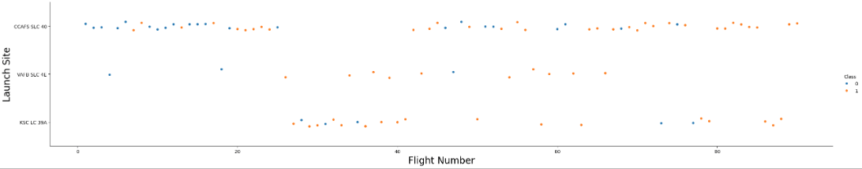
EDA with Data Visualization
We evaluate the relationship between the different features
Scatter plot to display results
Github Notebook URL: https://github.com/darwin-garcia/IBM-Data-Science/blob/main/Capstone/jupyter-labs-eda-dataviz-v2.ipynb

Slide 13
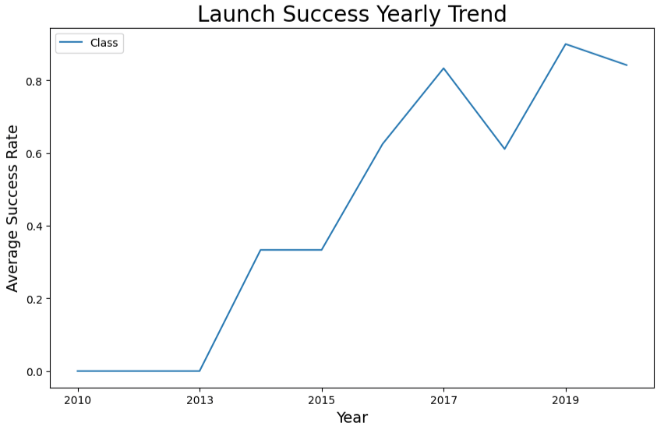
EDA with Data Visualization
Line Chart: Since 2013, we have observed that successful launches have continued to increase.
Finally, we perform one-hot encoding to formatting the features that’ll be used in successfully launch in the prediction
Github Notebook URL: https://github.com/darwin-garcia/IBM-Data-Science/blob/main/Capstone/jupyter-labs-eda-dataviz-v2.ipynb

Slide 14
EDA with SQL
Most commonly used SQL queries to answer the business questions
Github notebook URL: https://github.com/darwin-garcia/IBM-Data-Science/blob/main/Capstone/jupyter-labs-eda-sql-coursera_sqllite.ipynb
SQL Queries
%sql Select distinct(Launch_Site) from SPACEXTABLE
%sql Select Customer, sum(PAYLOAD_MASS__KG_) from SPACEXTABLE Where Customer = 'NASA (CRS)'
%sql Select Booster_Version, avg(PAYLOAD_MASS__KG_) from SPACEXTABLE Where Booster_Version like 'F9 v1.1%'
%sql Select date, min(Date), Landing_Outcome from SPACEXTABLE where Landing_Outcome like "%ground pad%"
%sql Select Mission_Outcome, count(Mission_Outcome) \from SPACEXTABLE group by Mission_Outcome
%sql select Date, substr("Date",6,2), Landing_Outcome, Booster_Version, Launch_Site from SPACEXTABLE where Landing_Outcome like '%fail%'and substr("Date",0,5) = '2015'
%sql Select Landing_Outcome, count(Landing_Outcome) as SLO from SPACEXTABLE \group by (Date Between '2010-06-04' and '2017-03-20') order by SLO desc

Slide 15
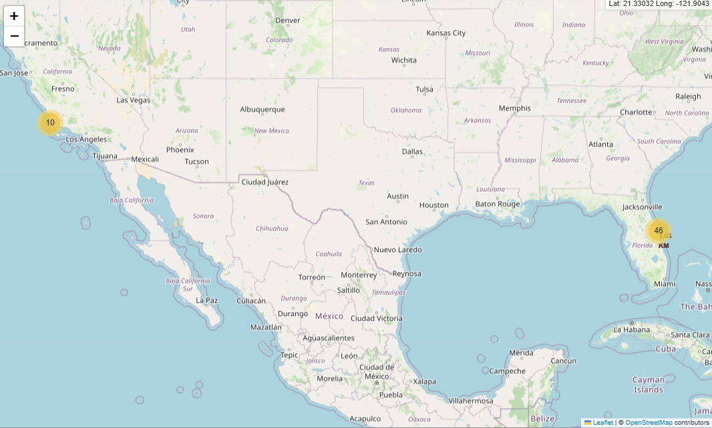
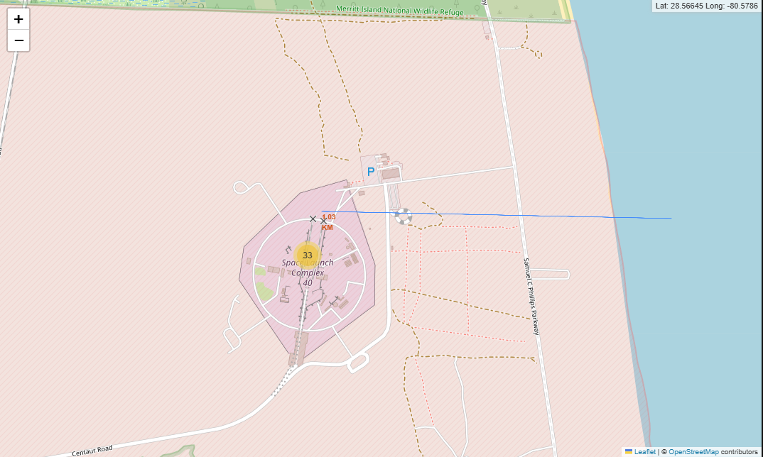
Build an Interactive Map with Folium
Mark all launch sites on a map with Folium
Use folium.circle() to create a circle for each launch site on the map based in decimal latitude and longitude
Use folium.map.Marker() to create a marker for each launch site on the map
Mark the success and failed launches for each site on the map
Here we use MarkerCluster() to containing many markers when having the same coordinate, the we label them as green and orange if then it’s success or failed
Calculate the distances between a launch site to landing proximity
MousePosition to get the coordinates on the map
Folium.polyline() to draw a line between the marker to the launch site and landing outcome
Github notebook URL: https://github.com/darwin-garcia/IBM-Data-Science/blob/main/Capstone/lab-jupyter-launch-site-location-v2.ipynb

Slide 16
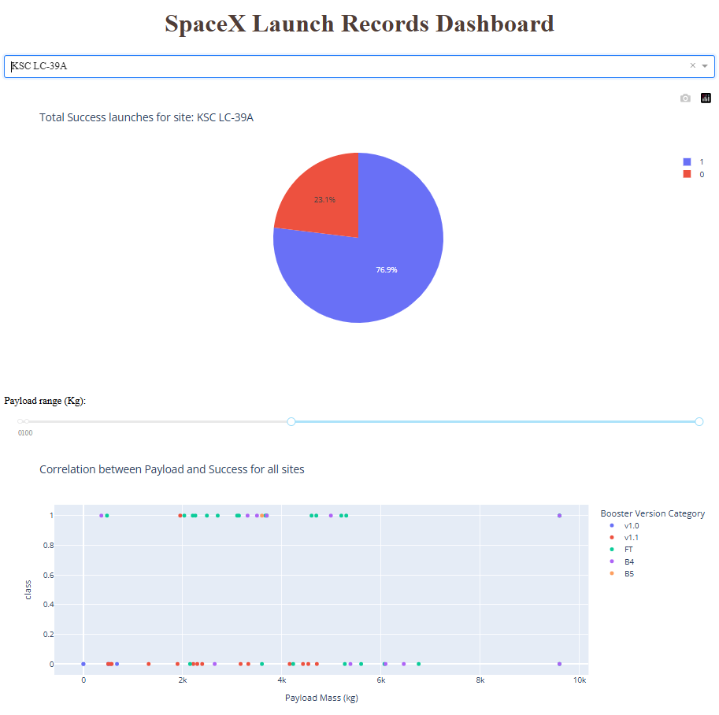
Build a Dashboard with Plotly Dash
Plots added into dashboard:
Pie Chart: Function to show the total successfully launches count for all starships
Input: All or specific launch sites
Output: Success and failed launched outcome
Scatter Chart: Function to show the correlation between payload and launch successfully
Input: All or specific launch site and Payload mass
Output: Success and failed launhed outcome
Slider object to select a Payload mass (kg)
Github URL of the completed Plotly Dash lab: https://github.com/darwin-garcia/IBM-Data-Science/blob/main/Capstone/spacex_dash_app.py

Slide 17
Predictive Analysis (Classification)
Logistic Regression
Decision Tree
SVM
KNN
Testing different classification models
Model development process
Github notebook URL: https://github.com/darwin-garcia/IBM-Data-Science/blob/main/Capstone/SpaceX-Machine-Learning-Prediction-Part-5-v1.ipynb
Data Preparation
Splitting
Data into train and test
Hyperparameter
Setup with GridSearchCV
Normalization
Sorting results
Training
Evaluation
Accuracy
Scoring
Prediction

Slide 18
Results
Exploratory data analysis results
Interactive analytics demo in screenshots
Predictive analysis results

Slide 19

Section 2

Slide 20
Flight Number vs. Launch Site
Show a scatter plot of Flight Number vs. Launch Site
Show the screenshot of the scatter plot with explanations

Slide 21
Payload vs. Launch Site
Show a scatter plot of Payload vs. Launch Site
Show the screenshot of the scatter plot with explanations

Slide 22
Success Rate vs. Orbit Type
Show a bar chart for the success rate of each orbit type
Show the screenshot of the scatter plot with explanations

Slide 23
Flight Number vs. Orbit Type
Show a scatter point of Flight number vs. Orbit type
Show the screenshot of the scatter plot with explanations

Slide 24
Payload vs. Orbit Type
Show a scatter point of payload vs. orbit type
Show the screenshot of the scatter plot with explanations

Slide 25
Launch Success Yearly Trend
Show a line chart of yearly average success rate
Show the screenshot of the scatter plot with explanations

Slide 26
All Launch Site Names
Find the names of the unique launch sites
Present your query result with a short explanation here

Slide 27
Launch Site Names Begin with 'CCA'
Find 5 records where launch sites begin with `CCA`
Present your query result with a short explanation here

Slide 28
Total Payload Mass
Calculate the total payload carried by boosters from NASA
Present your query result with a short explanation here

Slide 29
Average Payload Mass by F9 v1.1
Calculate the average payload mass carried by booster version F9 v1.1
Present your query result with a short explanation here

Slide 30
First Successful Ground Landing Date
Find the dates of the first successful landing outcome on ground pad
Present your query result with a short explanation here

Slide 31
Successful Drone Ship Landing with Payload between 4000 and 6000
List the names of boosters which have successfully landed on drone ship and had payload mass greater than 4000 but less than 6000
Present your query result with a short explanation here

Slide 32
Total Number of Successful and Failure Mission Outcomes
Calculate the total number of successful and failure mission outcomes
Present your query result with a short explanation here

Slide 33
Boosters Carried Maximum Payload
List the names of the booster which have carried the maximum payload mass
Present your query result with a short explanation here

Slide 34
2015 Launch Records
List the failed landing_outcomes in drone ship, their booster versions, and launch site names for in year 2015
Present your query result with a short explanation here

Slide 35
Rank Landing Outcomes Between 2010-06-04 and 2017-03-20
Rank the count of landing outcomes (such as Failure (drone ship) or Success (ground pad)) between the date 2010-06-04 and 2017-03-20, in descending order
Present your query result with a short explanation here

Slide 36

Section 3

Slide 37
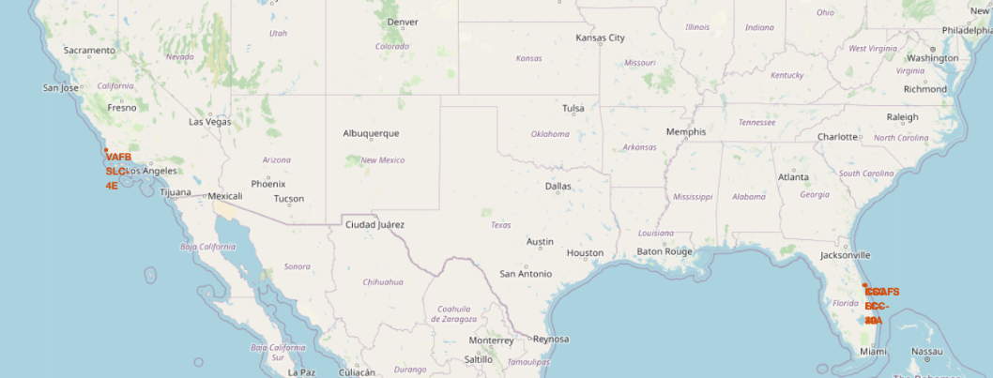
All launch sites aviables
Explain the important elements and findings on the screenshot

Slide 38
<Folium Map Screenshot 2>
Replace <Folium map screenshot 2> title with an appropriate title
Explore the folium map and make a proper screenshot to show the color-labeled launch outcomes on the map
Explain the important elements and findings on the screenshot

Slide 39
<Folium Map Screenshot 3>
Replace <Folium map screenshot 3> title with an appropriate title
Explore the generated folium map and show the screenshot of a selected launch site to its proximities such as railway, highway, coastline, with distance calculated and displayed
Explain the important elements and findings on the screenshot

Slide 40

Section 4

Slide 41
<Dashboard Screenshot 1>
Replace <Dashboard screenshot 1> title with an appropriate title
Show the screenshot of launch success count for all sites, in a piechart
Explain the important elements and findings on the screenshot

Slide 42
<Dashboard Screenshot 2>
Replace <Dashboard screenshot 2> title with an appropriate title
Show the screenshot of the piechart for the launch site with highest launch success ratio
Explain the important elements and findings on the screenshot

Slide 43
<Dashboard Screenshot 3>
Replace <Dashboard screenshot 3> title with an appropriate title
Show screenshots of Payload vs. Launch Outcome scatter plot for all sites, with different payload selected in the range slider
Explain the important elements and findings on the screenshot, such as which payload range or booster version have the largest success rate, etc.

Slide 44

Section 5

Slide 45
Classification Accuracy
Visualize the built model accuracy for all built classification models, in a bar chart
Find which model has the highest classification accuracy

Slide 46
Confusion Matrix
Show the confusion matrix of the best performing model with an explanation

Slide 47
Conclusions
Point 1
Point 2
Point 3
Point 4
…

Slide 48
Appendix
Include any relevant assets like Python code snippets, SQL queries, charts, Notebook outputs, or data sets that you may have created during this project

Slide 49


